Slide 1



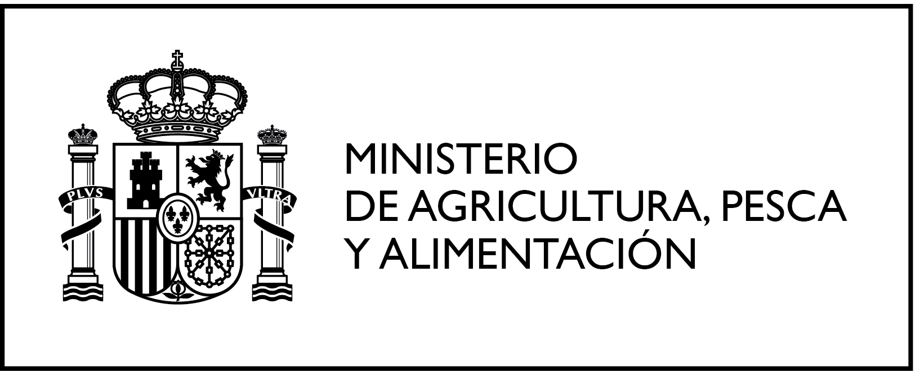
ANCARES Project
Multi-Regional Operational Group
Innovative tools for the analysis of land use and carbon levels in agroecosystems of sustainable dairy regions
January 2026 – January 2029 | Galicia and Asturias

Slide 2



Contents
Recommended structure
01. Context and objective
02. Participating entities
03. Activities and methodology
04. Progress / results
05. Next steps
ANCARES | Multi-Regional Operational Group

Slide 3
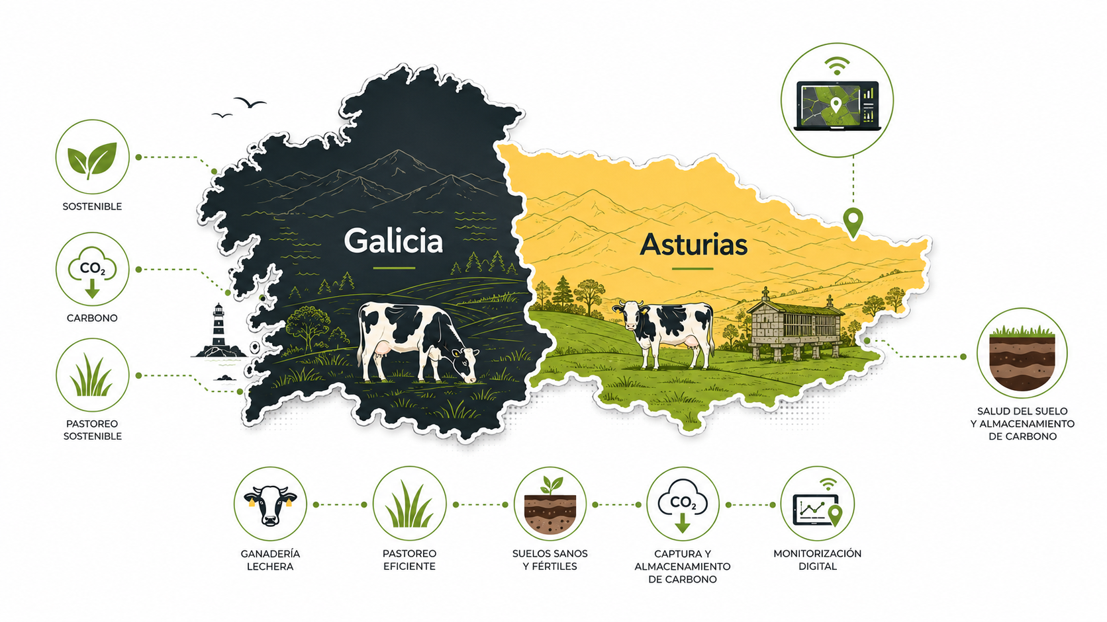
01. Context and objective
Project duration: January 2026 – January 2029
Towards climate-smart dairy farming
It aims to turn dairy farms into systems capable of capturing carbon, improving soil and reducing emissions, using technology and applied knowledge (technology + field + analysis).
• Analyses land use and carbon sequestration potential on dairy farms in Galicia and Asturias
• Develops a digital mapping and carbon scenario simulation tool, tested on farms
• Tools: Digital platform for farms and carbon and fertilisation monitoring systems.
2 regions
Galicia and Asturias
37 months of implementation (2026-2029)
ANCARES | Multi-Regional Operational Group

Slide 4






02. Participating entities
Beneficiary partners and collaborators
Beneficiary partners
Multi-actor project
Technology, science, the dairy sector and cooperatives working together on soil, carbon and digitalisation.
Collaborators / subcontracted entities
ANCARES | Multi-Regional Operational Group

Slide 5
03. Activities and methodology
38 technical activities spread over two periods (2026-2029)
Technical implementation
Dissemination and transfer
• Territorial mapping and field data collection (R1)
• Ideotypes of farms and validation Focus Groups (R2, R5)
• Physical, chemical and biological characterisation of soils in Asturias and Galicia (R3)
• Predictive algorithm and scaling up to the territorial base (R6)
• Carbon stocks, pilot plots and digital tool (R4, R7, R8)
• Dissemination and communication to the general public: promotional materials, website, social media, articles and launch event (RD1)
• Implementation and transfer in the sector: technical demonstration events, audiovisual shorts and mid-term webinar (RD2)
• Publications, Innovation Factsheets and final event in Madrid
ANCARES | Multi-Regional Operational Group

Slide 6
04. Progress / results
Period 1 milestones as of June 2026
Activity | Result | Period | Status
Territorial mapping tool | R1 | Jan - Nov 2026 | In progress
Identification of ideotypes of farms | R2 | Jan - Dec 2026 | In progress
Soil sampling in Asturias | R3 | Jan - Sept 2026 | In progress
High-resolution data capture with UAVs and various sensors | R4 | May - Sept 26 | In progress
Selection of pilot plots and experimental design | R7 | Jan - Jun 2026 | In progress
Digital tool and scenario simulation | R8 | Jan 2026 - April 2027 | In progress
Promotional materials | RD1 | Jan - Jun 2026 | In progress
Launch event | RD1 | Jan - Jun 2026 | Completed
Next milestone: collection of data from plots in Galicia (R1), in progress until October 2026
ANCARES | Multi-Regional Operational Group

Slide 7
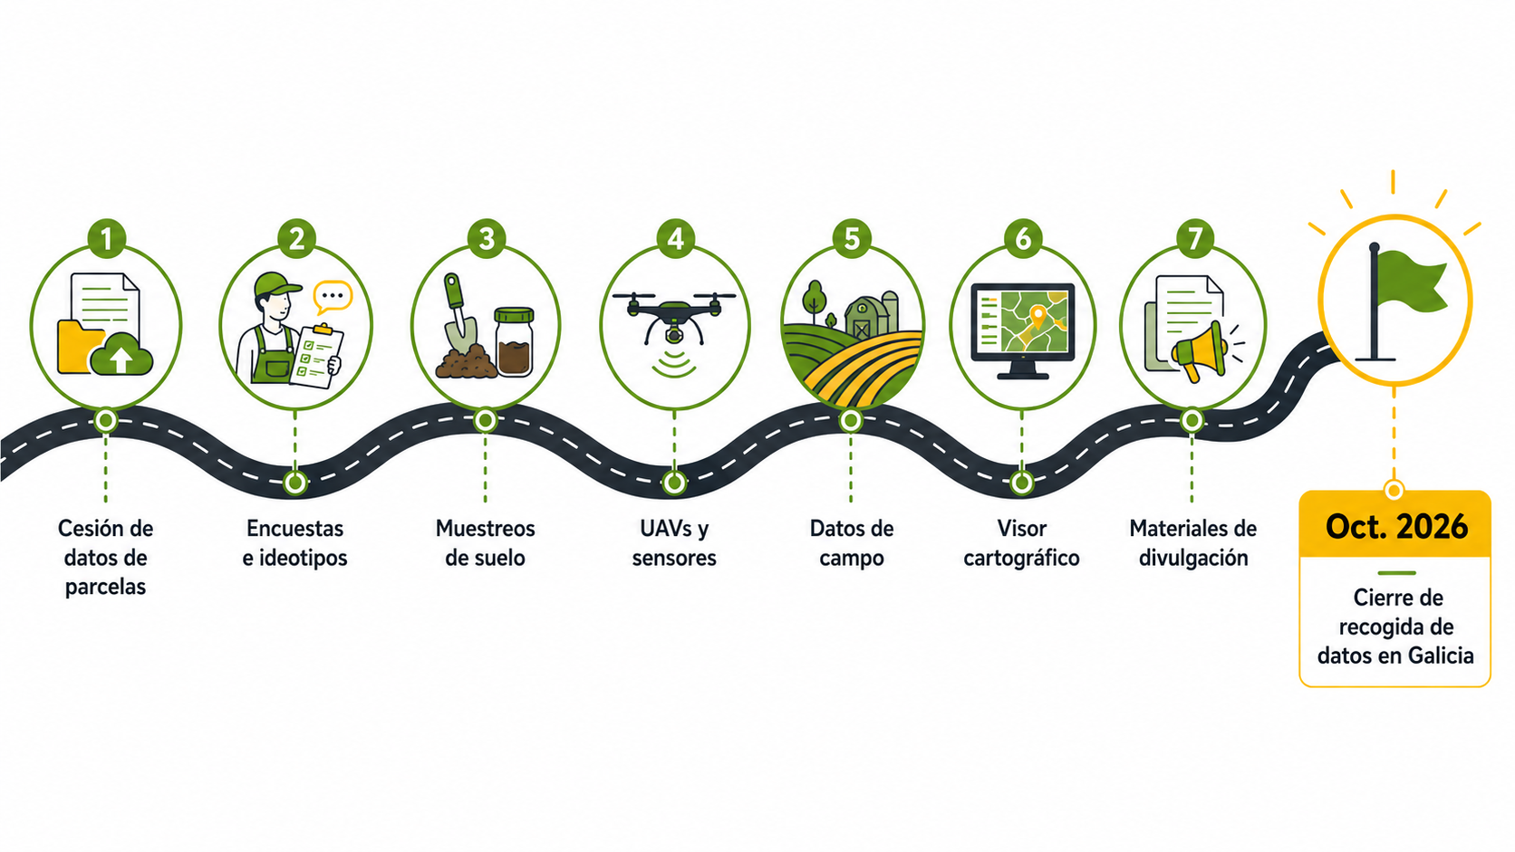
05. Next steps
Immediate milestones until the close of Period 1
Short-term roadmap
Completion of data transfer and compilation of plot data for Galicia (R1)
Generation of the territorial base and land parcel map of Galicia (R1)
Surveys of farmers and identification of farm ideotypes (R2)
Selection of representative farms and sampling areas (R2)
Soil sampling and field data collection (R3)
Planning/capture of data with drones and high-resolution sensors (R4/R6)
Progress in project dissemination materials and actions (RD1)
Next milestone
Oct. 2026
Territorial base of Galicia completed in order to advance R1
ANCARES | Multi-Regional Operational Group

Slide 8
Funding and publicity
Institutional framework and project funding
ANCARES. Innovative tools for the analysis of land use and carbon levels in agrosystems of sustainable dairy regions. (REGAGE25e00048404211) Innovation project of general interest by multi-regional operational groups of the European Innovation Partnership for Agricultural Productivity and Sustainability (EIP-AGRI), within the framework of Spain's CAP Strategic Plan (PEPAC). The Directorate-General for Rural Development, Innovation and Agri-Food Training (DGDRIFA) is the authority responsible for administering these grants. Funds from the European Rural Development Fund (80%) and the General State Administration (20%). Total project budget: EUR 596,769.91. Total grant: EUR 596,769.91.
ANCARES | Multi-Regional Operational Group

Slide 9


Thank you
ANCARES Operational Group | 2026 - 2029
ANCARES. Innovative tools for the analysis of land use and carbon levels in agrosystems of sustainable dairy regions. (REGAGE25e00048404211) Innovation project of general interest by multi-regional operational groups of the European Innovation Partnership for Agricultural Productivity and Sustainability (EIP-AGRI), within the framework of Spain's CAP Strategic Plan (PEPAC). The Directorate-General for Rural Development, Innovation and Agri-Food Training (DGDRIFA) is the authority responsible for administering these grants. Funds from the European Rural Development Fund (80%) and the General State Administration (20%). Total project budget: EUR 596,769.91. Total grant: EUR 596,769.91.

